Slide 1
PERSONAL FINANCIAL PLAN
Road to a condo down payment
Prepared by Joseph William Fields
Reviewed on the first of each month. Private and personal.
Snapshot as of February 2026
Personal Financial Plan
Private and personal

Slide 2
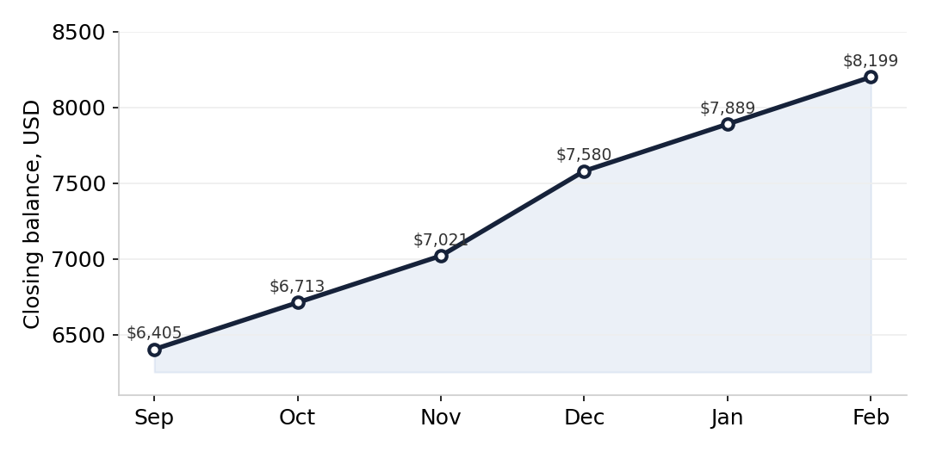
Savings Progress
Month | Balance
Sep 2025 | $6,404
Oct 2025 | $6,712
Nov 2025 | $7,021
Dec 2025 | $7,579
Jan 2026 | $7,889
Feb 2026 | $8,199
A larger deposit in December reflected a holiday bonus. Interest accrues at 1.50 percent APY on the savings account ending 8820, with a $300 automatic transfer on the 14th of each month.
Personal Financial Plan
Private and personal

Slide 3
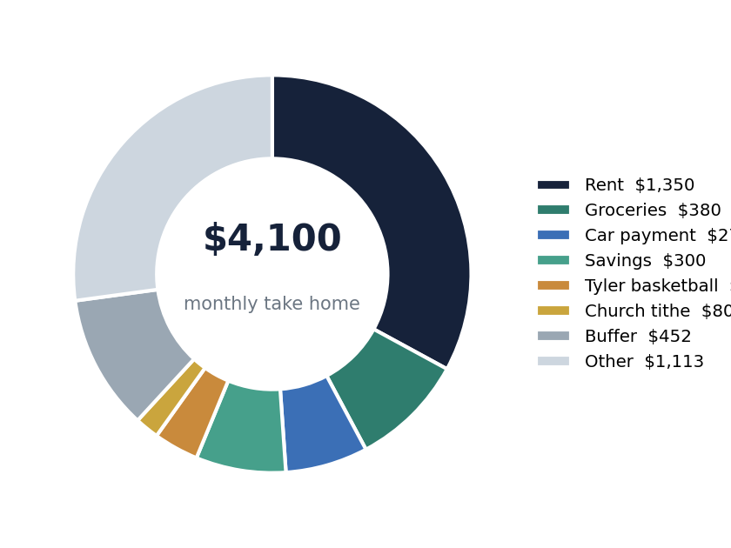
Goal and Monthly Allocation
$8,199
$20,000
41%
$300
Current savings
Goal
Funded
Saved monthly
Take home about $4,100
after taxes, child support, and benefits.
Every dollar is allocated. Rent is the largest line at $1,350. Savings and the Tyler basketball fund are treated as fixed and are not cut.
Personal Financial Plan
Private and personal

Slide 4
Monthly Budget Detail
Category | Monthly | Type
Rent | $1,350 | Fixed
Groceries | $380 | Variable
Car payment | $275 | Fixed
Savings, condo fund | $300 | Fixed
Tyler basketball fund | $150 | Fixed, do not cut
Church tithe | $80 | Fixed
Utilities, gas and electric | $230 | Variable
Buffer and overflow | $452 | Cushion
Discipline notes
Balance checked twice a week.
No purchase at or above $100 without a deliberate pause.
Child support of $850 is withheld before the paycheck and is not in this table.
On the current pace the down payment goal is reached in 2029.
Personal Financial Plan
Private and personal

